Slide 1

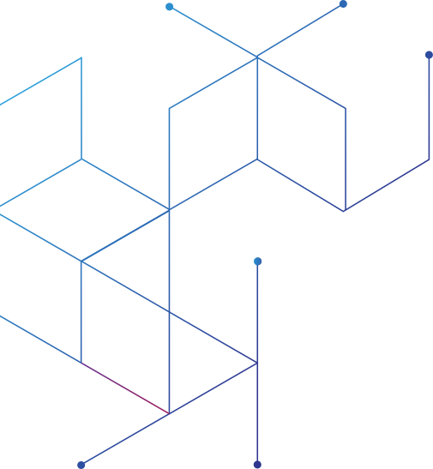


Alamein International University
Theoretical Algorithms Analysis Project
AbdulRhman Ibrahim
Hazem Oraby
Wafaa Muhammed
Rokia islam
Tasneem Ibrahim
22101286
22101052
22101116
22101084
22101382
1

Slide 2

Introduction
Definition: Dijkstra’s algorithm is a deterministic graph traversal method for finding the shortest paths from a single source to all other vertices in a graph with non-negative edge weights.
Key Characteristics:
Greedy strategy
Explores the most promising nodes first based on shortest tentative distance
Ensures optimal solution through local decision making
2

Slide 3
How it works
Set initial distances for all vertices: 0 for the source vertex, and infinity for all the other.
Choose the unvisited vertex with the shortest distance from the start to be the current vertex. So the algorithm will always start with the source as the current vertex.
For each of the current vertex's unvisited neighbor vertices, calculate the distance from the source and update the distance if the new, calculated, distance is lower.
We are now done with the current vertex, so we mark it as visited. A visited vertex is not checked again.
Go back to step 2 to choose a new current vertex, and keep repeating these steps until all vertices are visited.
In the end we are left with the shortest path from the source vertex to every other vertex in the graph.
3

Slide 4

Typical Applications:
1.
Real-time GPS and mapping systems (Google Maps, Waze)
2.
Dynamic route optimization in transportation networks
3.
Network routing protocols (OSPF, IS-IS)
4.
Game development for NPC pathfinding
4

Slide 5

Mathematical Foundations
Graph Model:
Dijkstra’s algorithm works on a directed graph with non-negative edge weights.
Objective:
Compute the minimum distance from a given source node to all other nodes in the graph.
1.
3.
Core Principle:
The algorithm maintains a set of nodes with known shortest paths and iteratively updates the distances to neighboring nodes using a greedy strategy
d(s,v)=P:s→vmin​(u,v)∈P∑​w(u,v)
Where d(s, v) is the shortest distance from source s to node v, and P is a path from s to v.
2.
4.
5

Slide 6
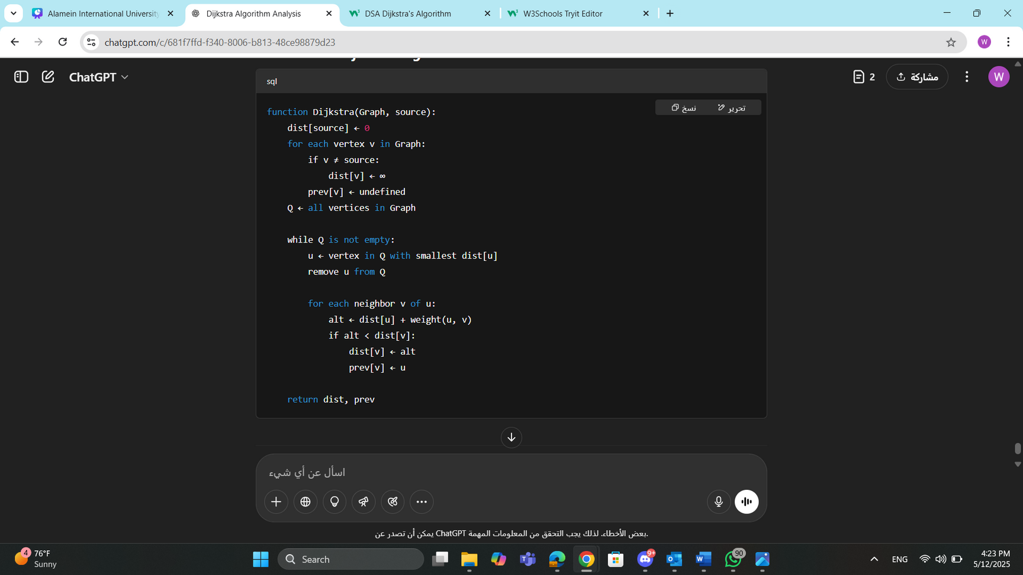
Time Complexity & Pseudocode
With V as the number of vertices in our graph, the time complexity for Dijkstra's algorithm is O(V2)
The reason why we get this time complexity is that the vertex with the lowest distance must to be search for to choose the next current vertex, and that takes O(V) time. And since this must to be done for every vertex connected to the source, we need to factor that in, and so we get time complexity O(V2) for Dijkstra's algorithm.
6

Slide 7
implementation and modifications
Implemented Dijkstra's Algorithm to compute the shortest path between selected areas.
Used real data: existing roads, new roads, traffic flow, and area names.
Calculated dynamic edge weights based on real-time traffic conditions (Morning, Afternoon, Evening, Night).
Enabled users to simulate road closures (e.g., accidents or maintenance).
Built graph using NetworkX and applied Dijkstra's algorithm for optimization
Specific Implementation and Modifications:
We adapted Dijkstra’s algorithm by calculating traffic-adjusted weights (distance × (1 + traffic_flow / 3000)), skipping roads with high congestion (>5000 veh/h), and penalizing missing traffic data. The system allows inputs like road closures and time of day, and outputs include clear directions, cost comparisons, and an interactive map for route visualization.
7

Slide 8
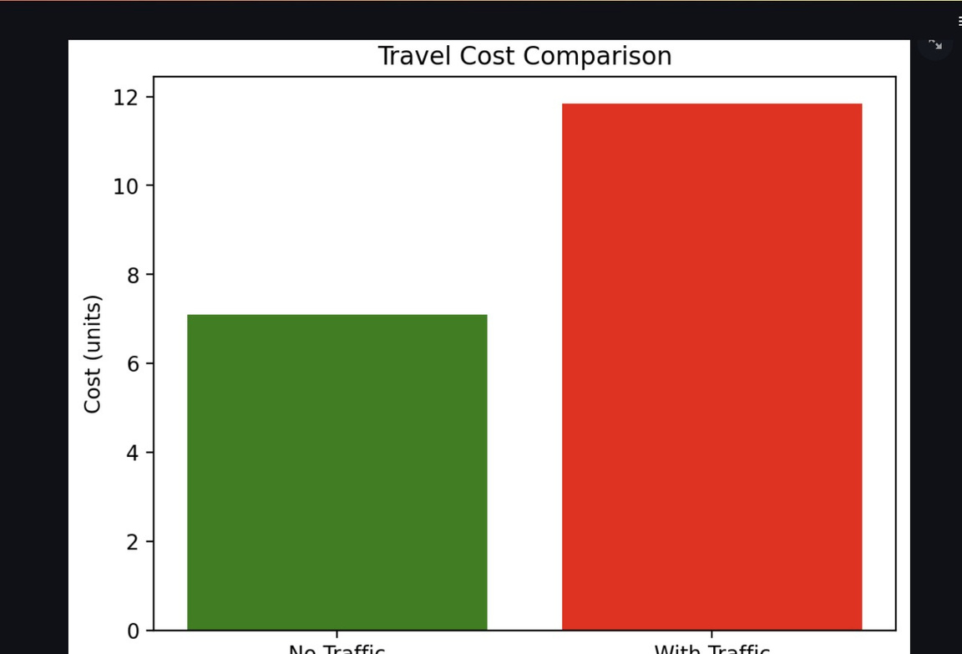
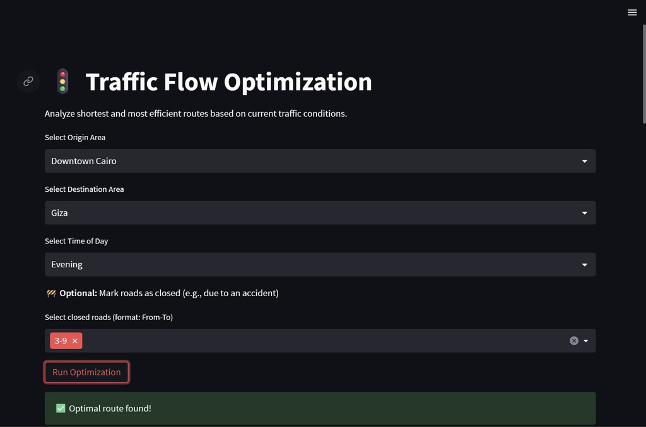

analysis results
8

Slide 9
comparison with alternatives
Algorithm Type | Strengths | Weaknesses | Suitability to Project
Dijkstra's Algorithm | Accurate shortest path, handles weighted graphs, easy to implement | Less efficient on large dense graphs without optimization | Best for real-time traffic-based routing
A* Search Algorithm | Faster with good heuristic, prioritizes goal-directed search | Requires a well-designed heuristic for accuracy | Suitable but needs spatial heuristics
Minimum Spanning Tree (Prim/Kruskal) | Optimizes total network cost, good for infrastructure planning | Not useful for point-to-point routing | Not ideal for dynamic route optimization
Greedy Algorithms | Fast and simple | Often suboptimal for global pathfinding | Too simplistic for traffic-aware routing

Slide 10
Conclusion & Lessons Learned
Conclusion:
Dijkstra’s algorithm proved effective for real-time route optimization in smart city transportation.
By integrating traffic data, we achieved more realistic and efficient routing decisions.
The algorithm’s flexibility allowed for dynamic adjustments such as road closures and time-based traffic variations.
Learned the importance of:
Preprocessing data to handle missing or extreme traffic values.
Choosing the right algorithm based on the problem context (e.g., sparse vs. dense graphs).
Enhancing user experience with visual feedback (charts, maps, step-by-step routes).
This project highlighted how classic algorithms like Dijkstra’s can be adapted and scaled for modern smart city needs.
10

Slide 11
Thank You
11

